Slide 1
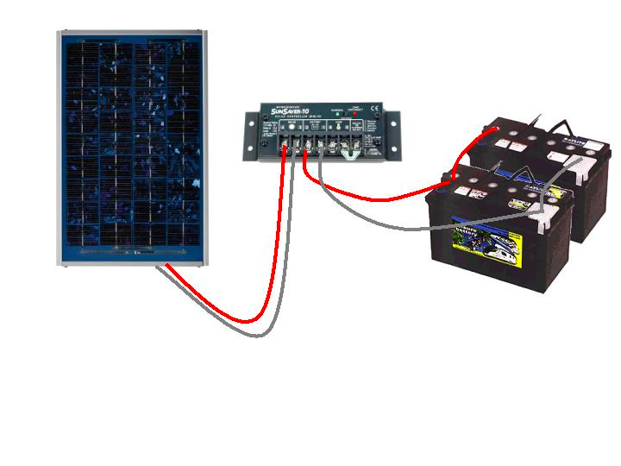
Solar power is used to charge the battery, and the battery is used to power the load.
http://midsummerenergy.co.uk/

